Slide 1
Welcome To York Code Dojo
Notes:
First meeting of 2017. We have being going about a Year now. Used to meet in town at a company called Isotona.
Spin off from Leeds Code Dojo
And York Games Dev, and York Code and Coffee
Myself, Chris and Daniel will run the first few sessions
After that, volunteers are welcome!

Slide 2
Agenda
Quick Introduction
Explain the problem
Work in pairs till 8.45pm
Opportunity to show off solutions
Pub about 9pm

Slide 3
What is a “Code Dojo”
A place to practice
A place to learn from and teach others
A place to try out new ideas and techniques
A place to have fun
Notes:
Practice – musical instruments, driving a car
People – different people using different languages from different companies
Ideas – try different languages and types of problems you don’t see during work
Fun - this isn’t work. You are here because you are interested, enjoying yourself is allowed!

Slide 4
Code Golf
The aim is try and make your source code as few as bytes as possible.
Demo even numbers up to 100
Notes:
It doesn’t have to be readable, maintainable or well written. Just short
Initial version
Show file size
Create solution file
Rename variables
Show file size
Check against solution file fc (called approval tests)
Remove if statement (but don’t correct loop)
Show file size
Check against solution file
static void Main(string[] args)
{
string answer = "";
for (int number = 1; number <= 100; number++)
{
if (number % 2 == 0)
{
answer = answer + number + " ";
}
}
Console.WriteLine(answer);
}

Slide 5
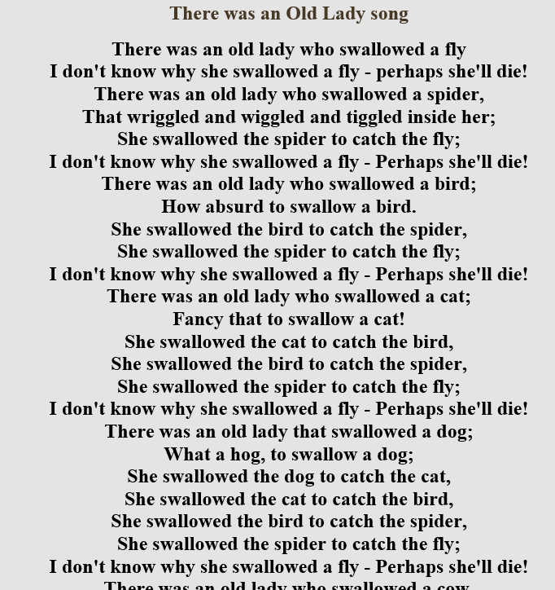
Tonight's problem
You need to output all the verses to the children's nursery rhyme
Notes:
Start with the full verse
Then start missing words out. Replace with …
And also gets replaced with …
There should be a blank line between each verse
The output should match the sample file

Slide 6
Rules
Your program’s output must match http://codegolf.azurewebsites.net/solution.txt
Your program should produce no additional output
The team with the smallest source code in bytes wins
There a few ways to cheat, so try to keep to spirt of the game.
That said, feel free to come up with clever solutions, but they might not be accepted!
Notes:
USB sticks
Show easy solution
Score board

Slide 7
Score board
Register your team on http://codegolf.azurewebsites.net
http://codegolf.azurewebsites.net/solution.txt
Update the score board as your get shorter files

Slide 8
Solutions
https://github.com/yorkCodeDojo/CodeGolf2

Slide 9
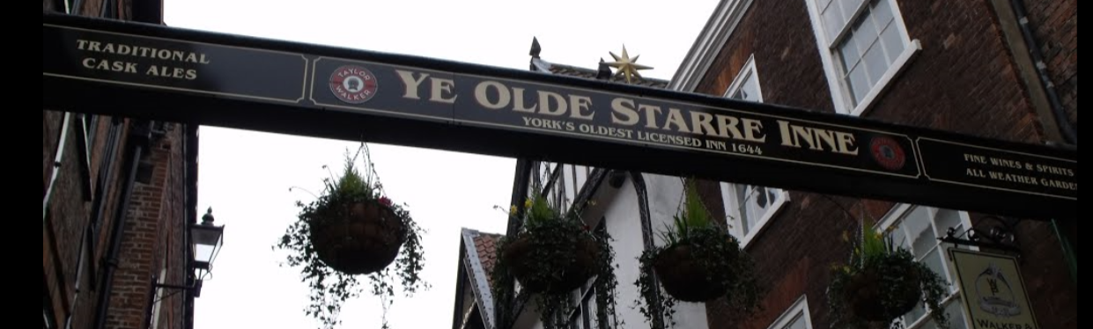
The End
Pub
Notes:
The pub is Ye Olde Starre Inne in Stonegate

